Slide 1


ALL ABOUT MOVIES.. Ayo, Lintu, Helin and Emma
Popular Culture: Thousands of films in 2000’s

Slide 2
DATASET
Source : Kaggle
Time: 2003-2022
# of Data used:
Before: 2000
Cleaned: 1647
Limitation: Not every movie is included

Slide 3
DATASET
Applications & Libraries
Python
Pandas
Plotly
HTML/CSS
JavaScript
D3.js
Charts.js
PostgreSQL

Slide 4
Objectives
What makes movies successful?
Do high budgets or released dates have an effect on its success?
What is the most successful genre?
Which countries made the most movie?
Whether runtime of the movies have changed over time?
Where are movies mostly filmed?

Slide 5
Quick tour to our “All about movies” page

Slide 6
Findings

Slide 7
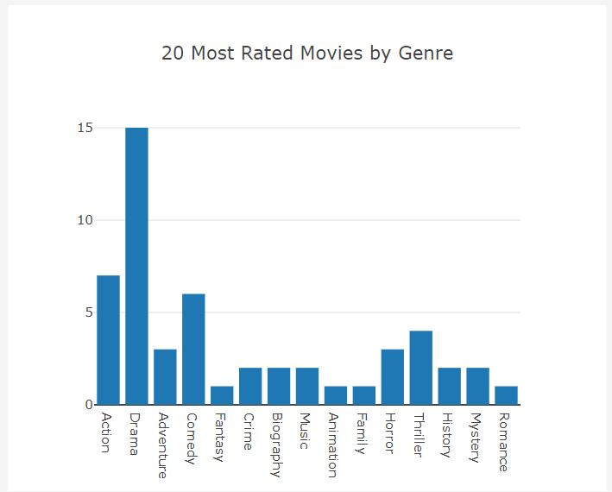
Genre Analysis
Drama is leader of the industry
Action is in second place followed by comedy
Fantasy is the least rated genre

Slide 8
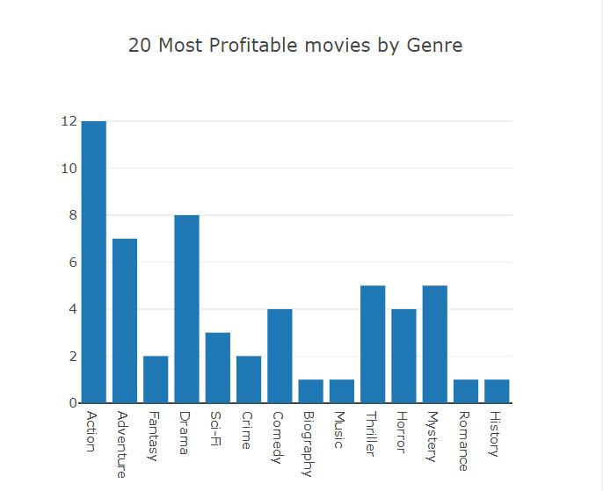
Genre Analysis continue
The most profitable genre is “Action”
Drama is the second most profitable
Adventure is in the 3rd place.

Slide 9
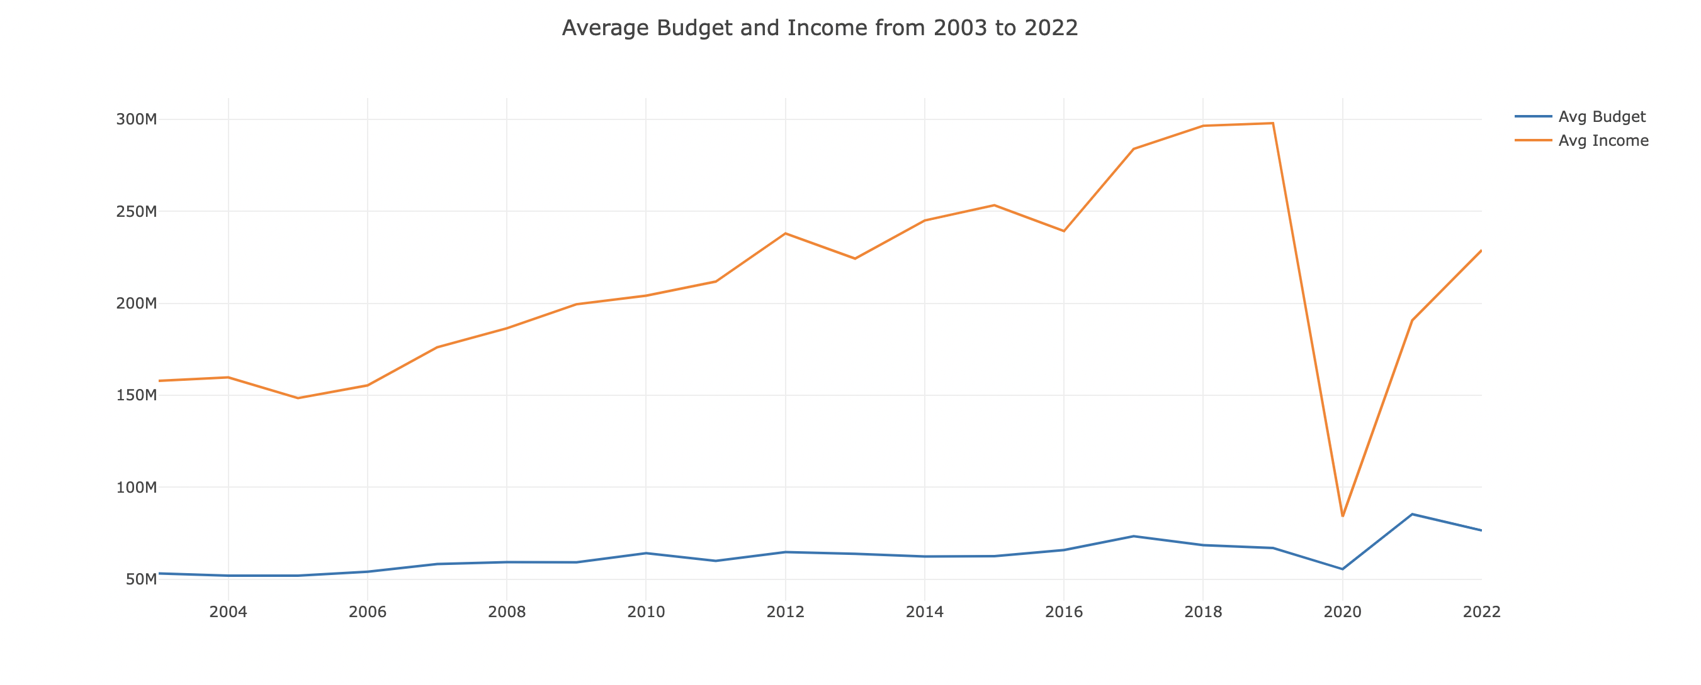
Budget vs Income
Average budget has a slight increase over time
Income has increased dramatically:
Technology ;↓production & distribution
Popular culture; ↑spending in leisure
Population growth
New markets ; China, Japan, S.Korea

Slide 10
Country Analysis

Slide 11
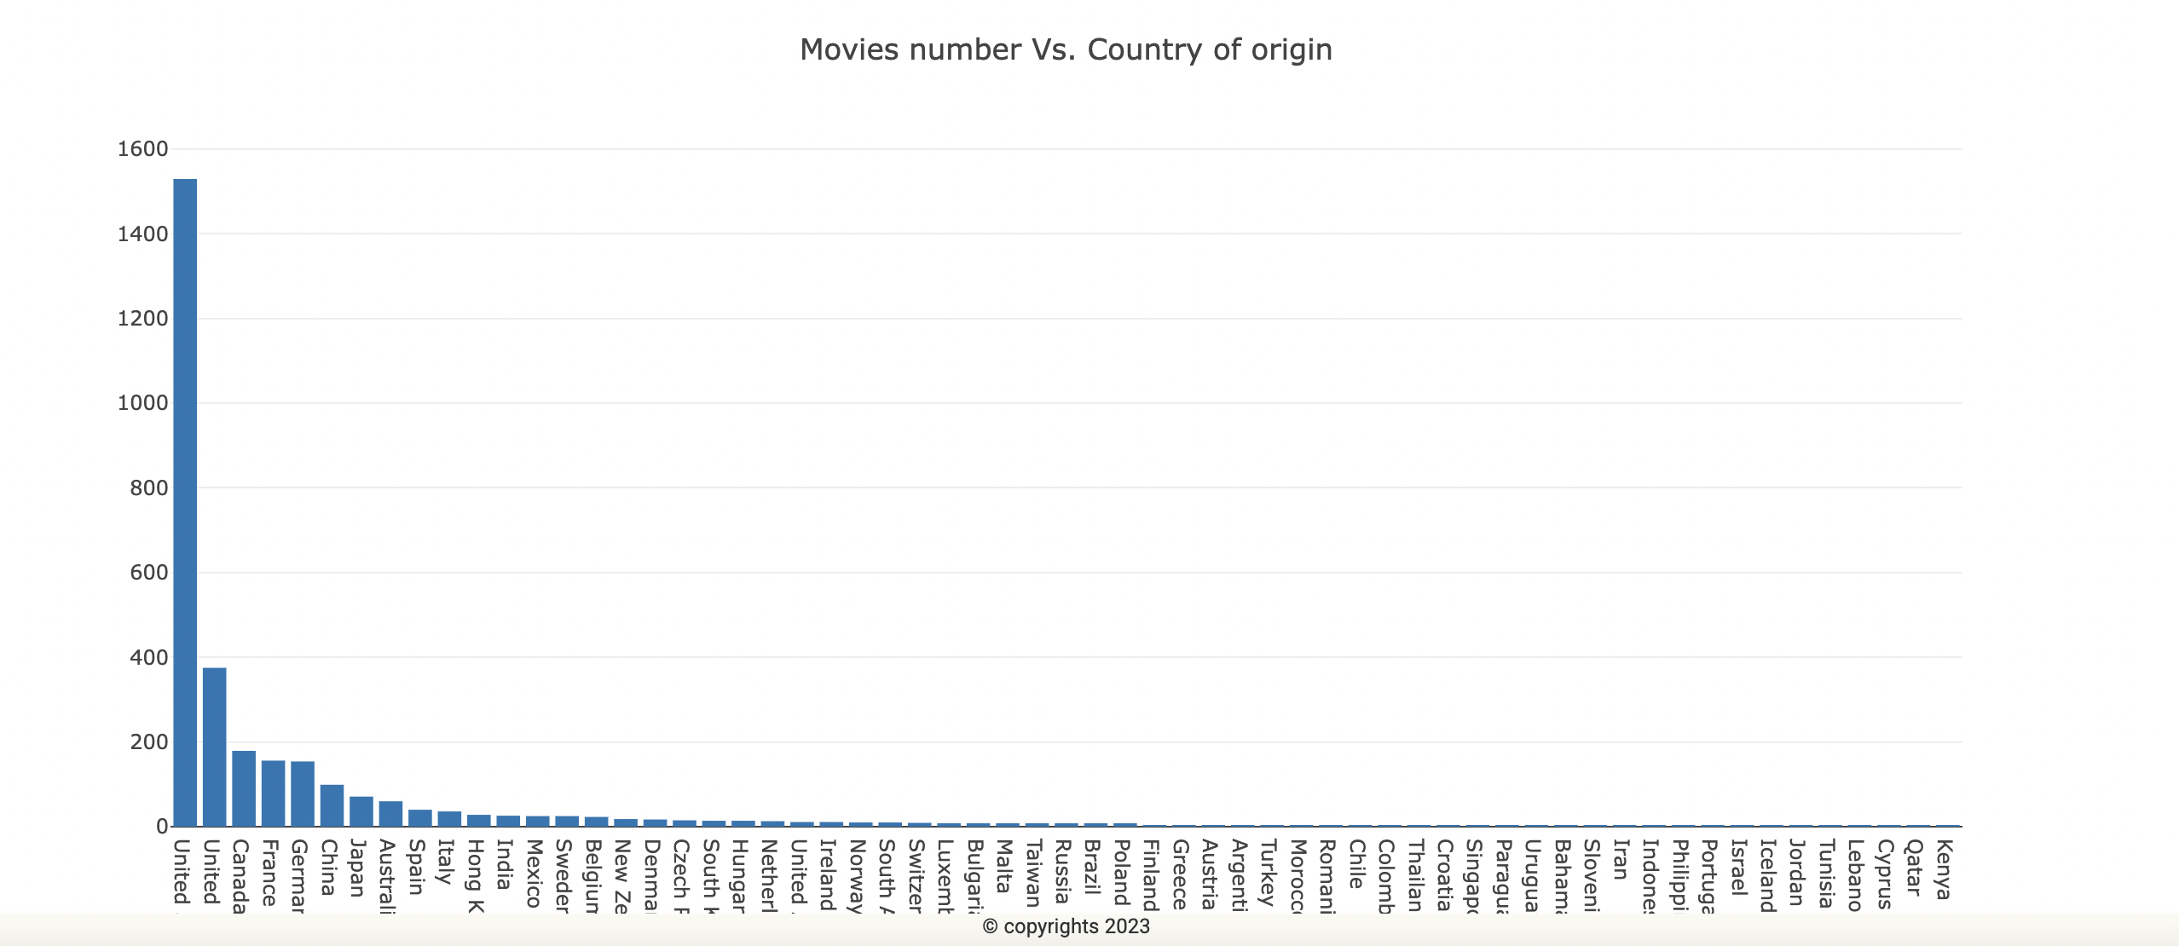
Country analysis
US is dominating the movie industry
Historical advantage
Big Five studios are US
Walt Disney
Warner Bros
Sony Pictures
Universal
English is leading language
Followed by UK and Canada

Slide 12
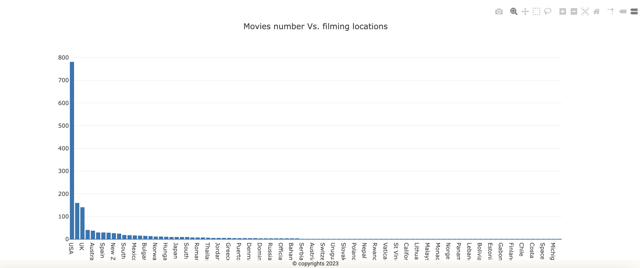
Country Analysis
Most movies are filmed in USA
Climate is the biggest factor(LA)
Cheaper to film
Followed by UK and Austria

Slide 13
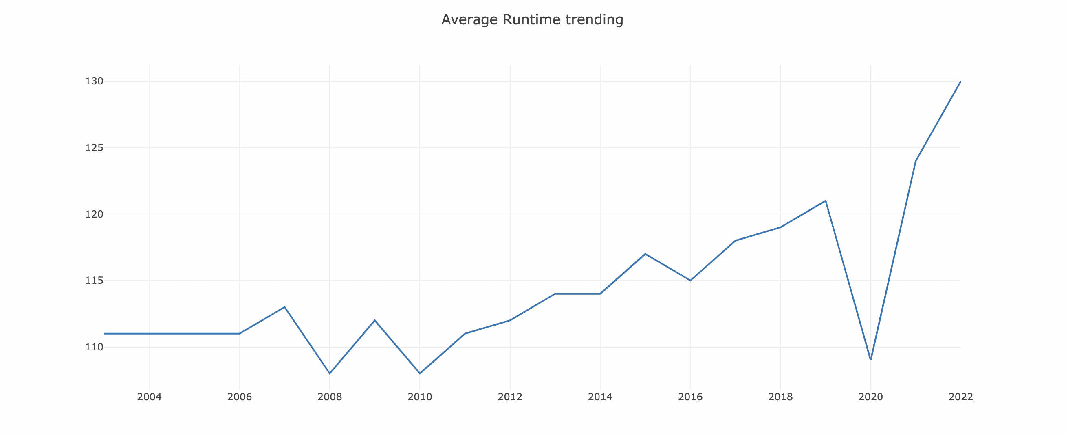
Runtime
Average runtime year over year fluctuates
Social events have significant effect on movies:
2008 financial crisis
2020 Covid-19 pandemic

Slide 14


